Slide 1
Importance of Reentry Programs in Reducing Recidivism
Student’s Name
Instructor’s Name
Date
Notes:
The presentation covers the importance of reentry programs in reducing recidivism

Slide 2
Introduction
Reentry programs help once convicted individuals to reenter the society
The main purpose of reentry programs is to reduce recidivism
These programs are offered to juveniles, and adults
Also, these programs work with convicts from all ethnic group
For example, blacks, whites and other ethnic groups in the United States
By reducing recidivism, the criminal justice public safety is improved
Also, the programs save money that would be used if recidivism cases are high
Notes:
Reentry programs help once convicted individuals to reenter the society. The main purpose of reentry programs is to reduce recidivism which refers to backsliding into crime by a convict by reoffending and involving themselves with criminal activities. Hence, the criminal justice have come up with these programs to reduce recidivism These programs are offered to juveniles, and adults and also works with convicts from all ethnic group, for example, blacks, whites and other ethnic groups in the United States. By reducing recidivism, the criminal justice public safety is improved and also, the programs save money that would be used if recidivism cases are high. Thus, reentry programs motivate convicts to be better individuals in the society

Slide 3
Types of Reentry Programs
One of the reentry program is Adult Reentry Programs
This program deals with adults from 18 years and above
Also, it gives services to both gender; males and females
The target of the program is prisoners who are about to reenter the society
Also, its services are offered to other community settings that deal with crime and delinquency
Notes:
There are several reentry programs that are ongoing in the United States. One of the reentry program is Adult Reentry Programs. This program deals with adults from 18 years and above and also, it gives services to both gender; males and females. In addition, the program offers services to all ethnic or race groups, for example, whites, blacks and other ethnic groups. The target of the program is prisoners who are about to reenter the society. This program is provided in the correctional facility centers holding prisoners and also to other community settings that deal with crime and delinquency.

Slide 4
Continuation…
Other countries also have reentry programs that help in reducing recidivism
In the British systems, anger and behavior management are provided in prisons
Some other treatment include counselling and health care treatments
From research studies, most prisons in Britain do not contain many programs (Nikhil, 2015)
Inadequate resources in prisons may be one of the challenges in British prisons
Others are lack of drug and alcohol treatment programs and lack of support from families
Notes:
Other countries also have reentry programs that help in reducing recidivism. In the British systems, anger and behavior management are provided in prisons. Some other treatment include counselling and health care treatments
From research studies, most prisons in Britain do not contain many programs. The psychologists and other health and mental health workers do not work appropriately in administering treatments and therapy sessions to inmantes in prison. Most of ex-convicts in Britain say that individuals struggle with many issues while in prison, but they do not get appropriate services that would help them to cope with the situations. Hence, when they are released, they would just go back to crime; thus, recidivism increases. Crime rates in the country are increasing because of lack of proper rehab programs.

Slide 5
Continuation..
The reentry programs in Britain are not effective in reducing recidivism
This is because there are nor enough rehabilitation programs in the prisons
Many individuals in prison are not looked after as they should while in prison
However, for women, situation is different they have few numbers in prison
Hence, they have a better chance of surviving in the society when released than men
However, it does not stop the rates of recidivism from increasing among women
Notes:
The reentry programs in Britain are not effective in reducing recidivism. This is because there are nor enough rehabilitation programs in the prisons. Many individuals in prison are not looked after as they should while in prison.
However, for women, situation is different they have few numbers in prison as they are provided with health care services and childcare services in or outside prison. Also, women are provided with few vocational and education training opportunities in jail. Hence, they have a better chance of surviving in the society when released than men
However, it does not stop the rates of recidivism from increasing among women

Slide 6
Reforming the British Reentry Program
The British government should consider reforming their reentry program
They should plan on how to implement such programs especially in male prisons
The programs that should be available include substance abuse and mental health programs
Other programs like education and employment training should be implemented
Research shows that 58% of women and 53% of men in jail lacked employment (Nikhil, 2015)
The government should consider providing funds for vocational training in prisons
Notes:
The British government should consider reforming their reentry program. This would help in decreasing recidivism with the country and among individuals. They should plan on how to implement such programs especially in male prisons since they occupy large percentage than women. The programs that should be available include substance abuse and mental health programs. These programs should aim in achieving the goal of reducing recidivism
Other programs like education and employment training should be implemented because research shows that 58% of women and 53% of men in jail lacked employment which led them to commit crimes. They keep reoffending due to lack of skills and employment. The government should consider providing funds for vocational training in prisons

Slide 7
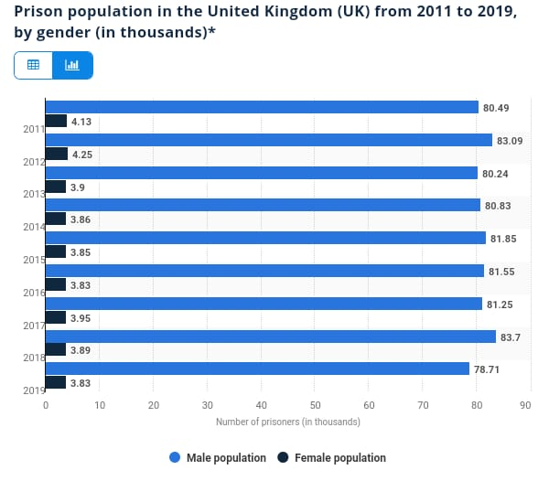
United Kingdom Data
Figure 1: Prison population in the United Kingdom (UK) from 2011 to 2019 by gender (in thousands)
Notes:
This graph shows the prison population in the UK from 2011 to 2019 elaborating further on gender to make the aspect of recidivism crystal clear.

Slide 8
Adult Reentry Programs
This program aims at helping individuals transition form prisons to their home communities
This program initiates treatments in prison to the adult participants (Ndrecka, 2014)
Their treatment services include substance abuse, education, and life skills
The programs give gender specific treatment care to each gender like females
The participants also are provided vocational/job training services while in prison
Notes:
These program aims at helping individuals transition form prisons to their home communities. The main goal of the program is to reduce recidivism among adult convicts. These programs initiate treatments in prison to the adult participants of both gender, either females or males. Their treatment services include substance abuse, education, and life skills, and counseling and therapy sessions. Other services include violent/sex offender treatment, and cognitive-behavioral programs. The programs give gender specific treatment care to each gender like females who are provided with cancer screening services or advice on birth control. The participants also are provided vocational/job training services while in prison which can help them start or find a job when they are released.

Slide 9
Continuation…
These programs are provided in the prison setting
In the community programs, services like counseling and therapy are provided
Other programs provided in the community include substance abuse treatment program (Ndrecka, 2014)
Work and employment release programs are provided by community programs
Also, housing programs, and female programs are also offered to released individuals.
The treatment services can be in different forms like individual or group treatment
Notes:
These programs are provided in the prison setting. However, the additional programs can also be found in the community. A released individual can decide to join the community programs for the services offered. In the community programs, services like counseling and therapy are provided. Other programs provided in the community include substance abuse treatment program, work and employment release programs, housing programs, and female programs. The treatment services for the programs can be in different forms like individual or group treatment
Other treatments include family treatment, mixed format treatment and case management treatments. These treatments are provided to the individuals and their loved ones if they want to participate too. For example family therapies are provided to help the individual get support from his or her family.

Slide 10
Continuation…
Some of the programs are mandated by the court while others are voluntary
One of the court mandated programs include substance abuse management
Hence, this program is mandated by the court to reduce substance-induced crimes
These reentry programs can be delivered in several settings leave alone prisons
This means that the programs can be delivered to areas that are not with jails
Notes:
Some of the programs are mandated by the court while others are voluntary. One of the court mandated programs include substance abuse management whereby, individuals
This is common because most convicts do crime activities due to drug intake
Hence, this program is mandated by the court to reduce substance-induced crimes
These reentry programs can be delivered in several settings leave alone prisons
Such settings include non-correctional facilities such as halfway houses
Another setting is community-based correctional facilities
This means that the programs can be delivered to areas that are not with jails

Slide 11
Adult Reentry Programs in US
Adult Reentry programs in United States are effective in reducing recidivism
Also, most reentry programs that target high-risk convicts are more effective
The recidivism rate has reduced by 47% via the effectiveness of the program (Berghuis, 2018)
For recidivism to reduce almost completely, the programs should be improved
Also, education programs should be provided to all individuals in prison
Notes:
Adult Reentry programs in United States are effective in reducing recidivism. Research shows that recidivism rates have effectively reduced in most states in the United States. Also, most reentry programs that target high-risk convicts are more effective because the people prone to reoffending have been rehabilitated and they have purposed to do things that would benefit them in a positive manner. The recidivism rate has reduced by 47% via the effectiveness of the program. However, there has been no increase or decrease of recidivism in some states because some of the facilities do not enough reentry programs. For recidivism to reduce almost completely, the programs should be improved such as major programs like substance abuse, employment and vocational training, and education programs should be provided to all individuals in prison.

Slide 12
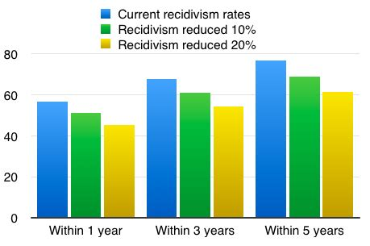
US Data
Figure 2: Recidivism rate in US
Notes:
The graph demonstrates the arte at which recidivism in US has been reducing over the years.

Slide 13
Conclusion
Reentry programs aim at reducing recidivism among offenders
Many programs in the US have led to the reduction of recidivism
Other countries should implement reentry programs to reduce recidivism
By reducing recidivism, the criminal justice public safety is improved
Also, the programs save money that would be used if recidivism cases are high
Thus, reentry programs motivate convicts to be better individuals in the society
Notes:
Reentry programs aim at reducing recidivism among offenders. Offenders who go through reentry programs either in prisons or in community-based facility centers rarely engage themselves in criminal activities due to the rehabilitation services they received through the programs. Many programs in the U.S have led to the reduction of recidivism because the ex-convicts have decided to lead a good life away from crimes and for the good of their families. Thus, reentry programs motivate convicts to be better individuals in the society. Other countries should implement reentry programs to reduce recidivism. By reducing recidivism, the criminal justice public safety is improved. Also, the programs save money that would be used if recidivism cases are high and be used in other sectors such as health or eradication of poverty.

Slide 14
References
Berghuis, M. (2018). “Reentry Programs for Adult Male Offender Recidivism and Reintegration: A Systematic Review and Meta-Analysis.” International Journal of Offender Therapy and Comparative Criminology 62(14):4655–76
Ndrecka, M. (2014). “The Impact of Reentry Programs on Recidivism: A Meta- Analysis.” PhD diss., University of Cincinnati, 2014
Nikhil. R. (2015). An international perspective of how other countries prepare their prisoners for release.

